Slide 2
" In The Name of Allah, The Most Beneficent, The Most Merciful" Guidelines for Halal Laboratories By: Dr. Hani M. Al-Mazeedi

Slide 3
Scope
This document aims to provide a brief overview of the main scientific and Islamic shariah guidelines for laboratories where the tests carried out are for Halal and Quality purposes.
The importance of these laboratories is to provide necessary technical supports to strengthen Halal certification Services.

Slide 4
It is impossible to issue an honest Halal certificate for any Halal product or a Halal service without a certificate from laboratory analysis from a Halal and Quality Laboratory.

Slide 5
Outline
General requirements for Halal and Quality Laboratories
Critical test parameters for evaluating Halal products & equipment
Issues and challenges of a Halal and Quality laboratories
Requirements of GSO-GAC for Halal Laboratory
Conclusions
Recommendations

Slide 6
The Halal Lab must comply with the Elements of GLP**
General requirements for Halal Laboratories*
QA/QC Programs
Laboratory Conditions
Labeling of test Samples
Test Measurements
Records Management
Health & Safety Management
*GSO-GAC accredited Halal Laboratory
** Good Laboratory Practices

Slide 7
Purpose of the elements of GLP*
Element Purpose
QA/QC Programs To ensure consistent quality of test data
Laboratory conditions To ensure conditions are optimized
Labeling of test samples To preserve the identity and integrity of the
samples for testing
Test Measurements To ensure that the test methods used are acceptable and will produce expected
performance
Records Management To enable efficient retrieval of undistorted
information
Health & Safety Management To provide safe working environment
*Performing Good Laboratory Practices, GLP to maximize the quality of testing and calibration in servicing customers.

Slide 8
Requirements of Halal Quality laboratory in non-Muslim countries
Duties for the laboratory managerial personnel
Management Quality System Requirements
Technical requirements (QA*/QC Programs)
Certification for Halal laboratory

Slide 9
Requirements* that must be taken into account when establishing a Halal Quality laboratory in non-Muslim countries are the followings:
The organization shall** ensure that the laboratory or the organization of which it is part of is an entity that can be held legally responsible.
*Details of Halal laboratory requirements will not be covered here.
**shall = must

Slide 10
The organization shall ensure that the responsibility of the laboratory to carry out its testing and calibration activities in such a way as to meet the requirements of ISO 17025:2005 and ISO 17065:2012 International Standards.
It shall also ensure that it satisfy the needs of the customer¹, the regulatory authorities² or organizations providing recognition³ (i.e. GSO-GAC FAD 04, and GSO-GAC FAD 12) .

Slide 11
It must show its technical capabilities to conduct the approved methods in Halal analysis performed by Muslim specialist.
The organization shall ensure that the management system covers work carried out in the laboratory’s permanent facilities.

Slide 12
Where the required analysis are not available in the laboratory’s permanent facilities the organization can collaborate with external laboratories with the condition that such laboratories meet the special quality of the analysis and calibration described in the international standard of ISO 17025:2005.

Slide 13
If the laboratory is part of an organization performing activities other than testing and/or calibration, the organization shall ensure that a key designated personnel in the organization is involved or has an influence on the testing and/or calibration activities of the laboratory in order to identify potential conflicts of interest.

Slide 14
The organization shall ensure it has policies and procedures:
1. To avoid the involvement of its employee with any activities that would diminish confidence in the laboratory competence, impartiality, judgment or operational integrity.
2. Its management and personnel are free from any undue internal and external commercial, financial and other pressures and influences that may adversely affect the quality of their work.

Slide 15
3. To protect of its customers’ confidential information and proprietary rights, including procedures for protecting the electronic storage and transmission of results.
4. To ensure appointment of a managerial¹ and technical personnel².

Slide 16
Duties for the laboratory managerial personnel
1. Irrespective of his responsibilities, he must have the authority¹ and resources² needed to carry out his duties, including the implementation¹ and maintenance² of a management system.
2. And to identify* the occurrence of departures from the management system¹ or from the procedures² for performing tests and/ or calibrations, and to initiate** actions to prevent¹ or minimize² such departures.

Slide 17
3. Define the organization and management structure of the laboratory, its place in any parent organization, and the relationships between quality management¹, technical operations², and support services³.

Slide 18
4. Specify the responsibility, authority and interrelationships of all personnel who manage¹, perform² or verify work³ affecting the quality of the tests and/or calibrations.

Slide 19
5. Provide adequate supervision of testing and calibration staff, including trainees, by persons familiar with methods¹ and procedures, purpose² of each test and/or calibration³, and with the assessment⁴ of the test or calibration⁴ results.

Slide 20
6. Have a technical manager* which has overall responsibility for the technical operations¹ and the provision of the resources needed² to ensure the required quality of laboratory operations.

Slide 21
7. Appoint a member of staff as quality manager** (however named) who, irrespective of other duties and responsibilities, shall have defined responsibility and authority for ensuring that the management system related to quality is implemented and followed at all times.

Slide 22
8. The quality manager shall have direct access to the highest level of management at which decisions are made on laboratory policy or resources.
9. Appoint deputies for key managerial personnel.

Slide 23
10. Ensure that its personnel are aware of the relevance and importance of their activities and how they contribute to the achievement of the objectives of the management system.

Slide 24
The top management of the organization shall ensure that appropriate communication processes are established within the laboratory and that communication takes place regarding the effectiveness of the management system.

Slide 25
Management Quality System Requirements
1. Introduction
2. Documentation and Control of records
3. Review of requests, tenders and contracts
4. Purchasing services and supplies
5. Corrective action
6. Management reviews

Slide 26
1. Introduction
The organization shall establish, implement and maintain a management system appropriate to the scope of its activities.
The organization shall ensure that the laboratory’s management system policies are related to quality and that quality policy statements are defined in a quality manual.

Slide 27
The quality policy statements shall be issued under the authority of top management. It should include:
a) the laboratory management’s commitment to good professional practice (Good Laboratory Practices, GLP) ¹ and to the quality of its testing² and calibration³ in servicing its customers.

Slide 28
b) It should also include the management’s statement of the laboratory’s standard of service, and
c) the purpose of the management system related to quality*.

Slide 29
d) It should also include a requirement that all personnel concerned with testing and calibration activities within the laboratory familiarize themselves with the quality documentation¹ and implement the policies² and procedures³ in their work; and

Slide 30
e) the laboratory management’s commitment to comply with the International Standards* and to continually improve the effectiveness of the management system., and that
f) the laboratory management’s commitment to comply with Islamic requirements*, the Government regulations and relevant Food Safety & Quality Standards.
*ISO 17025: 2005, ISO 17065: 2012, GSO, GAC FAD 04, and GAC FAD 12

Slide 31
2. Documentation and Control of records
The organization shall ensure maintaining procedures to control all documents that form part of its management system, such as regulations¹, standards², other normative documents³ and manuals⁴.

Slide 32
The organization shall ensure that the laboratory have procedures to protect and back-up records stored electronically and to prevent unauthorized access¹ to or amendment of these records².

Slide 33
The organization shall ensure that management system documents are uniquely identified and includes the date of issue and/or revision identification.
The organization shall ensure that any changes to the document is reviewed and approved by the same function that performed the original review.

Slide 34
3. Review of requests, tenders and contracts
The organization shall ensure that the laboratory establish and maintains procedures for the review of requests¹, tenders² and contracts³.

Slide 35
The policies and procedures for these reviews leading to a contract for testing and/or calibration shall ensure that:

Slide 36
a) the requirements, including the methods to be used are adequately defined, documented and understood.
b) the laboratory has the capability and resources to meet the requirements.
c) the appropriate test and/or calibration method is selected and is capable of meeting the customers’ requirement.

Slide 37
4. Purchasing services and supplies
The organization shall have in place policies¹ and procedure(s)² for the selection and purchasing of services¹ and supplies² it uses that affect the quality of the tests and/ or calibrations.

Slide 38
Procedures shall include purchase¹, reception² and storage³ of reagents and laboratory consumable materials relevant for the tests and calibrations.
The organization shall ensure that all purchased supplies have been inspected/ verified as complying with standard specifications/ requirements defined in the methods for the tests and/ or calibrations concerned before being used.

Slide 39
The organization shall ensure that purchasing documents contain data describing the services¹ and supplies² ordered, and that the documents are reviewed¹ and approved² for technical content prior to release.

Slide 40
5. Corrective action
The organization shall ensure that its laboratory establishes a policy¹ and procedure² and designates appropriate authorities³ for implementing corrective action when non-conforming work in the management system¹ or technical operations² have been identified.

Slide 41
6. Management reviews
The organization shall ensure to periodically conduct a review of the laboratory’s management system¹ and testing² and/ or calibration³ activities to ensure their continuing suitability and effectiveness, and to introduce necessary changes¹ or improvements².
The review shall take account of:

Slide 42
a) suitability of policies¹ and procedures².
b) reports from managerial and supervisory personnel.
c) the outcome of recent internal audits.
d) corrective and preventive actions.
d) assessment by external bodies.
e) the results of inter-laboratory comparisons or proficiency tests.
f) changes in the volume¹ and type² of the work.
g) customer feedback.
h) complaints.
recommendations for improvement.
j) other relevant factors, such as quality control activities¹, resources² and staff training³.

Slide 43
Technical requirements (QA*/QC Programs)
1. Personnel
2. Accommodation and environmental conditions
3. Standard Operating Procedures (SOP’s)
*Quality Assurance Programs need to be in place to ensure quality of test data.

Slide 44
1. Personnel
The organization shall ensure the competence of all who operate specific equipment¹, perform tests² and/ or calibrations³, evaluate results⁴, and sign test reports⁵ and calibration certificates⁶. Staff undergoing training shall be supervised appropriately.

Slide 45
2. Accommodation and environmental conditions
The organization shall ensure that the laboratory facilities for testing¹ and/ or calibration², including but not limited to energy sources³, lighting⁴ and environmental conditions⁵ shall facilitate correct performance of the tests and/ or calibrations.

Slide 46
3. Standard Operating Procedures (SOP’s)
1. Test and calibration methods and method validation
2. Equipment
3. Measurement traceability
4. Sampling
5. Assuring the quality of test and calibration results
6. Reporting the results

Slide 47
1. Test and calibration methods and method validation
The organization shall ensure that the laboratory uses appropriate methods¹ and procedures² for tests and/ or calibrations within its scope.

Slide 48
The organization shall ensure that the laboratory have instructions¹ on the use and operation² of all relevant equipment¹, and on the handling² and preparation³ of items for testing and/ or calibration or both, where the absence of such instructions could jeopardize the results of tests and/ or calibrations.

Slide 49
All instructions¹, standards², manuals³ and reference data⁴ relevant to the work of the laboratory shall be kept up to date and made readily available.

Slide 50
The organization shall ensure that when it is necessary to use methods not covered by standard methods, they are subject to agreement with the customer and shall include a clear specification of the customer’s requirements¹ and the purpose² of the test and/ or calibration³.
The methods developed shall have been validated appropriately before use.

Slide 51
2. Equipment
The organization shall ensure that the laboratory is furnished with all items of sampling¹, measurement² and test equipment³ required for the correct performance of the tests and/ or calibrations.

Slide 52
The organization shall ensure that the equipment and its software used is capable of achieving the accuracy required and shall comply with specifications relevant to the tests and/ or calibrations concerned.

Slide 53
The organization shall ensure that the equipment is operated by authorized personnel.
Instructions on the use and maintenance of equipment shall be up to date and readily available.

Slide 54
3. Measurement traceability
The organization shall ensure that all equipment used for test and/ or calibrations, including subsidiary measurements that have significant effect on the accuracy or validity of the test results are calibrated¹ before being put into service and are traceable² to the International System of Units (SI) or to appropriate measurement standards.

Slide 55
The organization shall ensure that the laboratory have a program¹ and procedure² for the calibration of its reference standards.

Slide 56
4. Sampling
The organization shall ensure that the laboratory have a sampling plan¹ and procedures² for sampling of substances¹, materials² or products³ for subsequent laboratory analysis or calibration.

Slide 57
The sampling plan shall be based on appropriate statistical methods and shall address the factors to be controlled to ensure the validity of the test¹ and calibration results².
The organization shall ensure that all sampling activities be carried out by trained¹ and certified² personnel.

Slide 58
5. Assuring the quality of test and calibration results
The organization shall ensure that there are quality control procedures for monitoring the validity¹ of tests and calibrations² undertaken.

Slide 59
The resulting data shall be recorded in such a way that trends are detectable and, statistical techniques shall be applied to the reviewing of the results.
The monitoring shall be planned¹ and reviewed² but not limited to the following:

Slide 60
regular use of certified reference materials (CRM’s) ¹ and/ or internal quality control² using secondary reference materials³.
b) participation in inter-laboratory comparison¹ or proficiency- testing programs².
c) replicate tests or calibrations using the same or different methods.
d) retesting or recalibration of retained items.
e) correlation of results for different characteristics of an item.

Slide 61
6. Reporting the results
The organization shall ensure that the results of each test, calibration, or series of tests or calibrations carried out by the laboratory shall be reported accurately¹, clearly², objectively³, and in accordance with any specific instructions in the test or calibration methods.

Slide 62
Certification for Halal laboratory
1. Organization
2. Compliance

Slide 63
1. Organization
A laboratory for Halal testing and analysis is audited by a competent authority (e.g. external Islamic auditing company and certified by an accredited Halal certification body).

Slide 64
2. Compliance
For Halal compliance laboratory testing and analysis deemed to conform to this standard, it shall comply with this standard.
This shall be verified through inspection when deemed necessary by an accredited Halal Certification body*.
* Another activity for Halal and Quality Laboratory

Slide 65
When a products considered as Halal?
For a product to be Halal it must be free from the followings
Meat, fat, or gelatin or any parts of pig.
Free blood (gushing blood) at any stage of production.
Alcohol or wine at any stage of production.
Growth media/substrate and processing aids of Haram sources.
Non religiously slaughtered meat.
Human parts.
Najes materials (e.g. parts of insects, dung, urine, or carrion).
Non-tolerated levels of Health Hazardous substance (M, P, and C).
*M: microbial, P: physical, and C: chemical

Slide 66
Halal and Quality Laboratory Protocols
These are analyses and testing procedures that are usually carried out in Halal and Quality laboratory.
Halal tests aims to detect and identify one or more of substances that are:
harmful to human health (the Tayeb¹ side of Halal) or
check the presence of suspicious components, Makrooh, or forbidden (Haram), as outlined by the Islamic Sharia (the Halal² side).

Slide 67
These lab tests, range from very simple¹ to very sophisticated² ones using very expensive equipments.
In the Halal industry, Halal tests are usually carried out for Halal products to make sure that they are safe¹ (free of health hazards), do not contain non-Halal components², all Halal stages of production and stages of cleansings (Tahara)³ were performed in an acceptable manner.

Slide 68
Examples of equipment used in Halal testing and Halal R&D
Fourier Transform Infrared (FTIR) spectroscopy
Fluorimetry
Electronic Nose (E-Nose) technology
Differential Scanning Calorimetry (DSC)
Molecular Biology Techniques (PCR, ELISA)
Chromatography (e.g. GC, GC-FID, GC-ToF-MS, HPLC, GC-MS)
Etc.
Gas chromatography (GC), Gas chromatography–mass spectrometry (GC-MS), Fourier transform infrared spectroscopy (FTIR),
High-performance liquid chromatography (HPLC), Polymerase chain reaction (PCR), enzyme-linked immunosorbent assay (ELISA)

Slide 69
Critical test parameters for evaluating Halal products & equipment
Determination of Pork Fat, Lard & Lard Derivatives via GC, GC-MS, FTIR, PCR, ELISA Test
Detection of the presence of Alcohol via GC, GC-MS, FTIR
Characterization and comparison of Gelatin from Animal and plant based origin via FTIR, PCR, ELISA Test
Protein Expression to predict quality of Halal Meat via Immunochemistry test, ELISA, Fluorimetry
Detection of Pig’s blood in processed & raw products via PCR, ELISA Test, FTIR, DNA test
Fatty Acid Profiling of Meat Products via GC-MS
Gas chromatography (GC), Gas chromatography–mass spectrometry (GC-MS), Fourier transform infrared spectroscopy (FTIR),
High-performance liquid chromatography (HPLC), Polymerase chain reaction (PCR), enzyme-linked immunosorbent assay (ELISA)

Slide 70
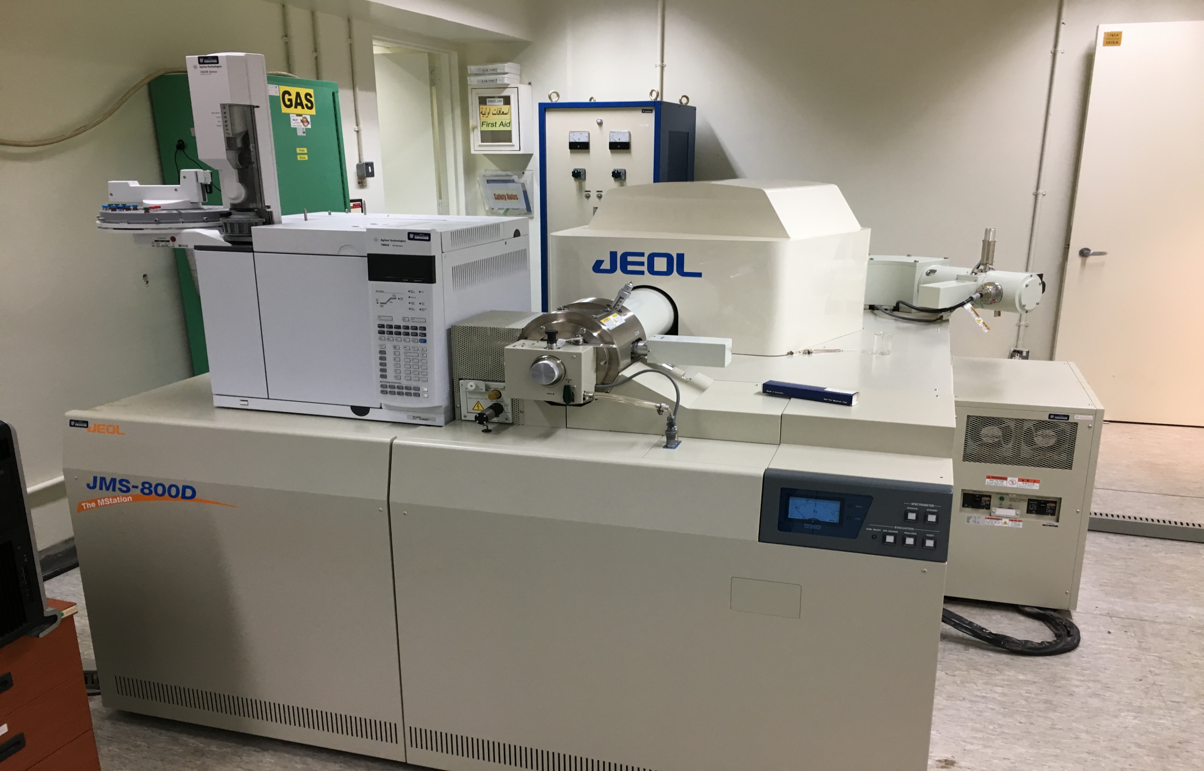
GC-MS High resolution
JEOL, Japan

Slide 71
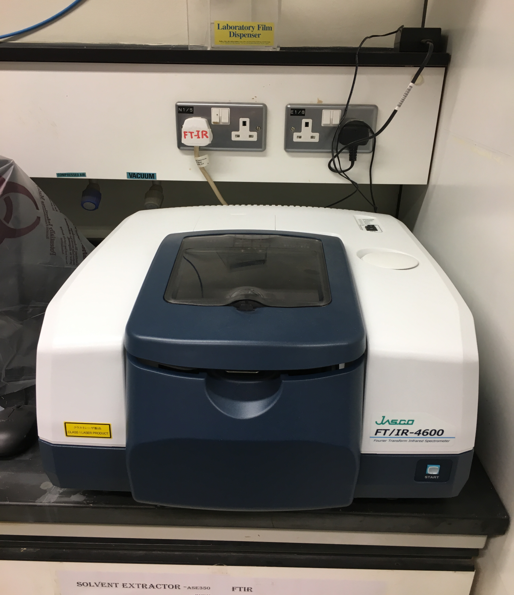
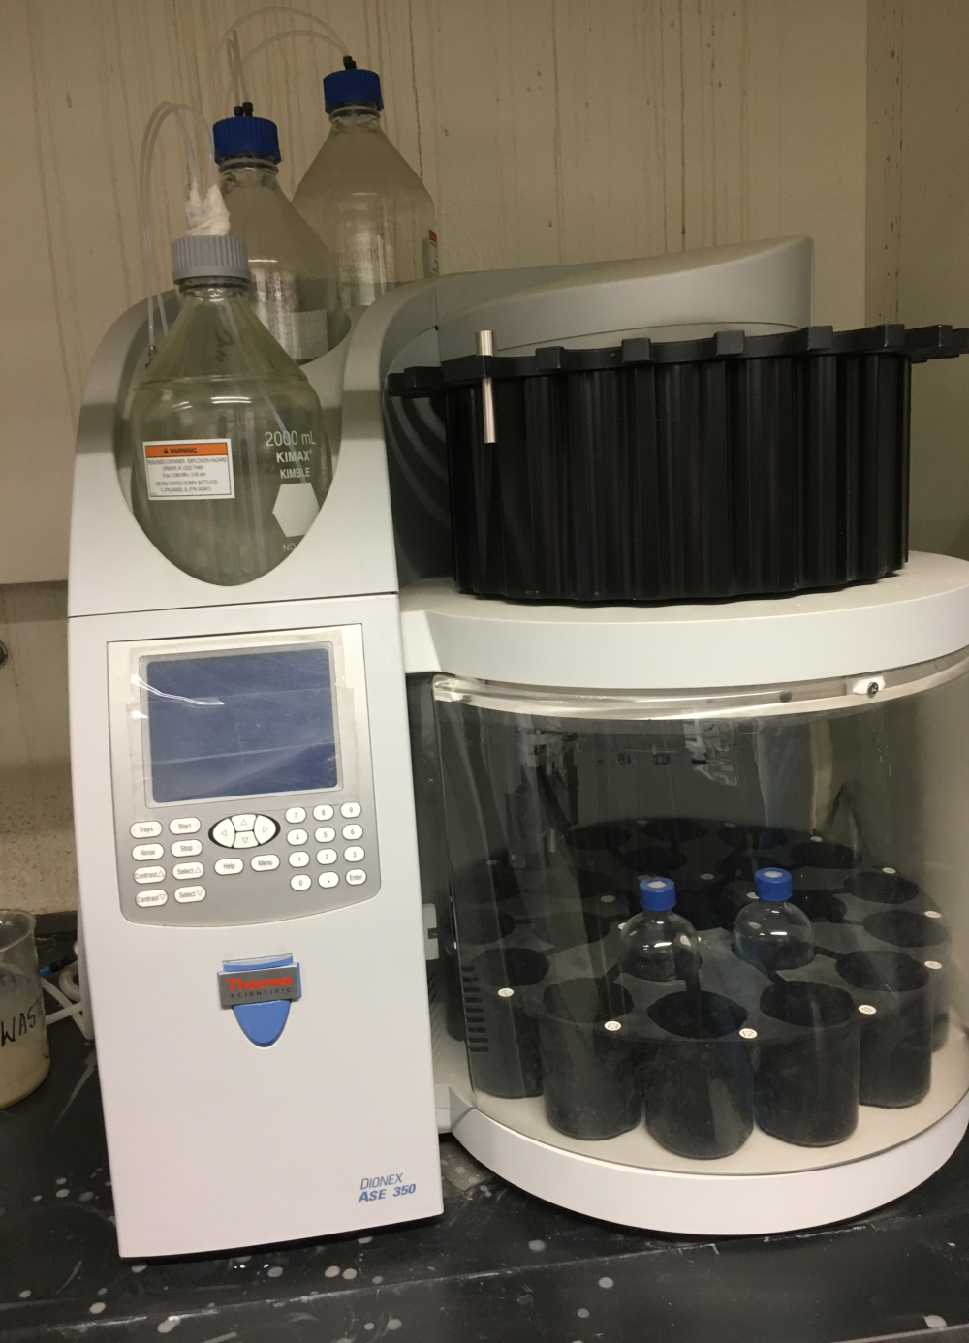
Infra Red FTIR
Extraction equipment

Slide 72
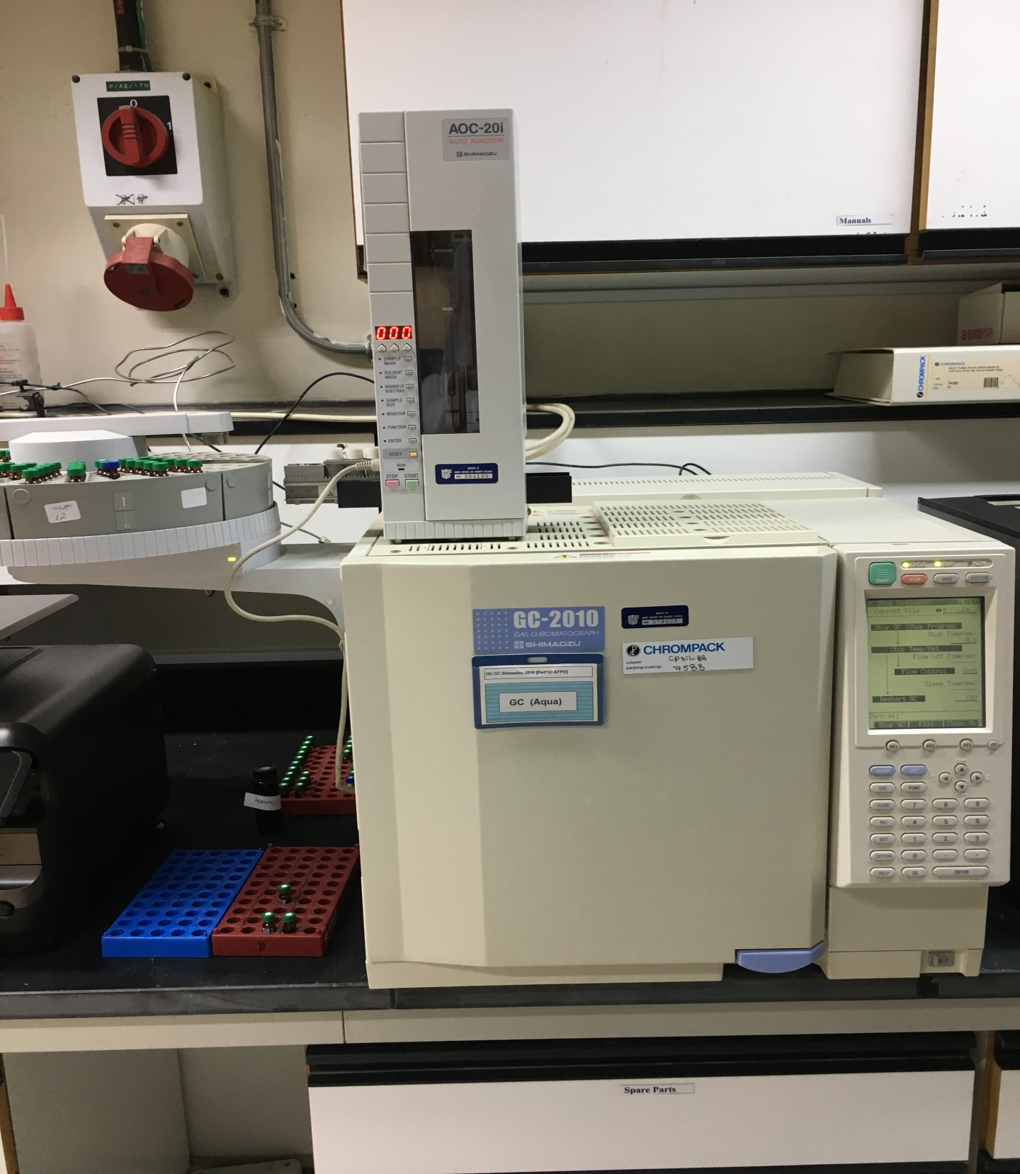
GC
Shimadzu, Japan

Slide 73
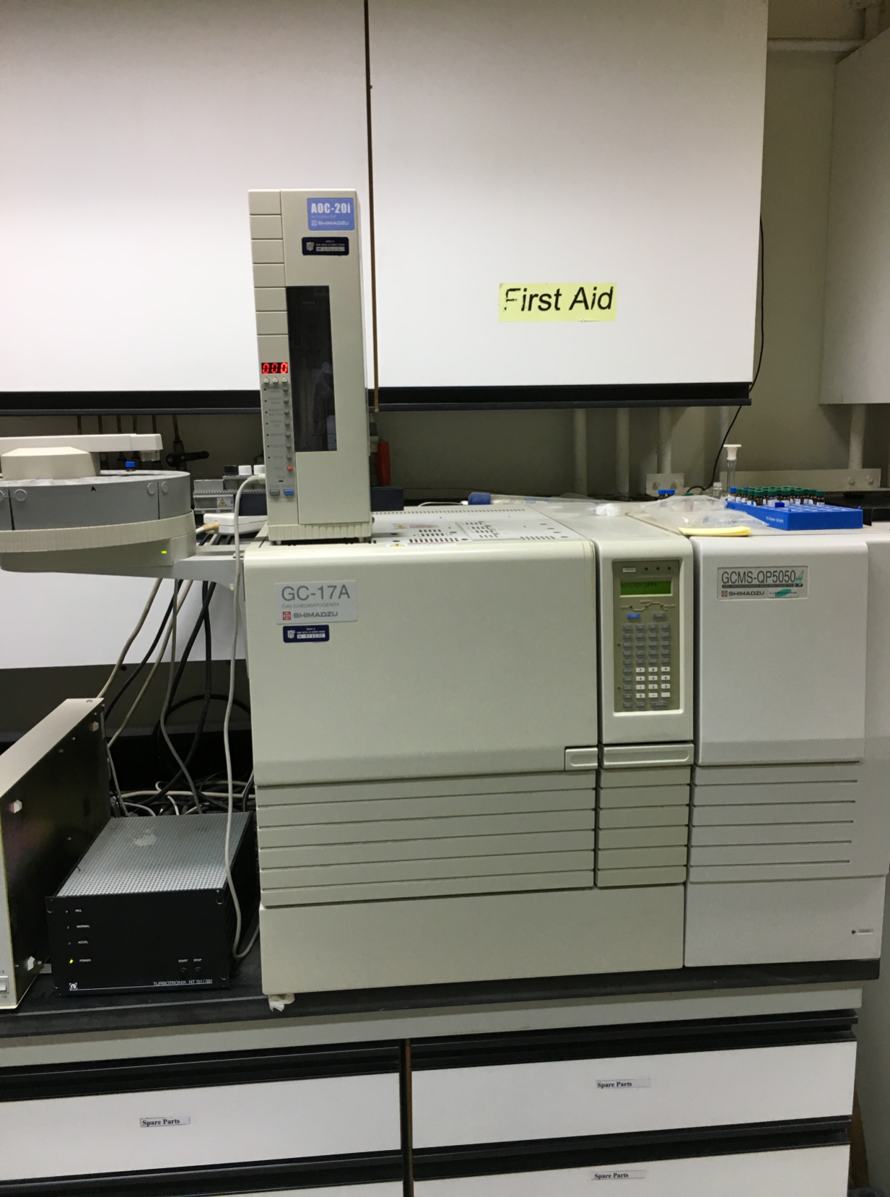
GC-MS
Shimadzu, Japan

Slide 74
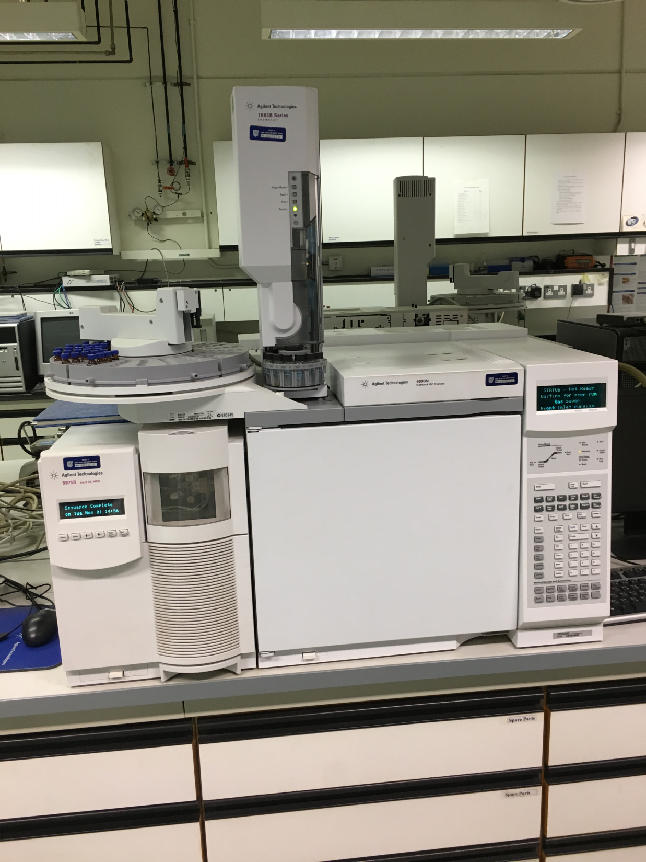
GC-MS
Agilent, USA

Slide 75
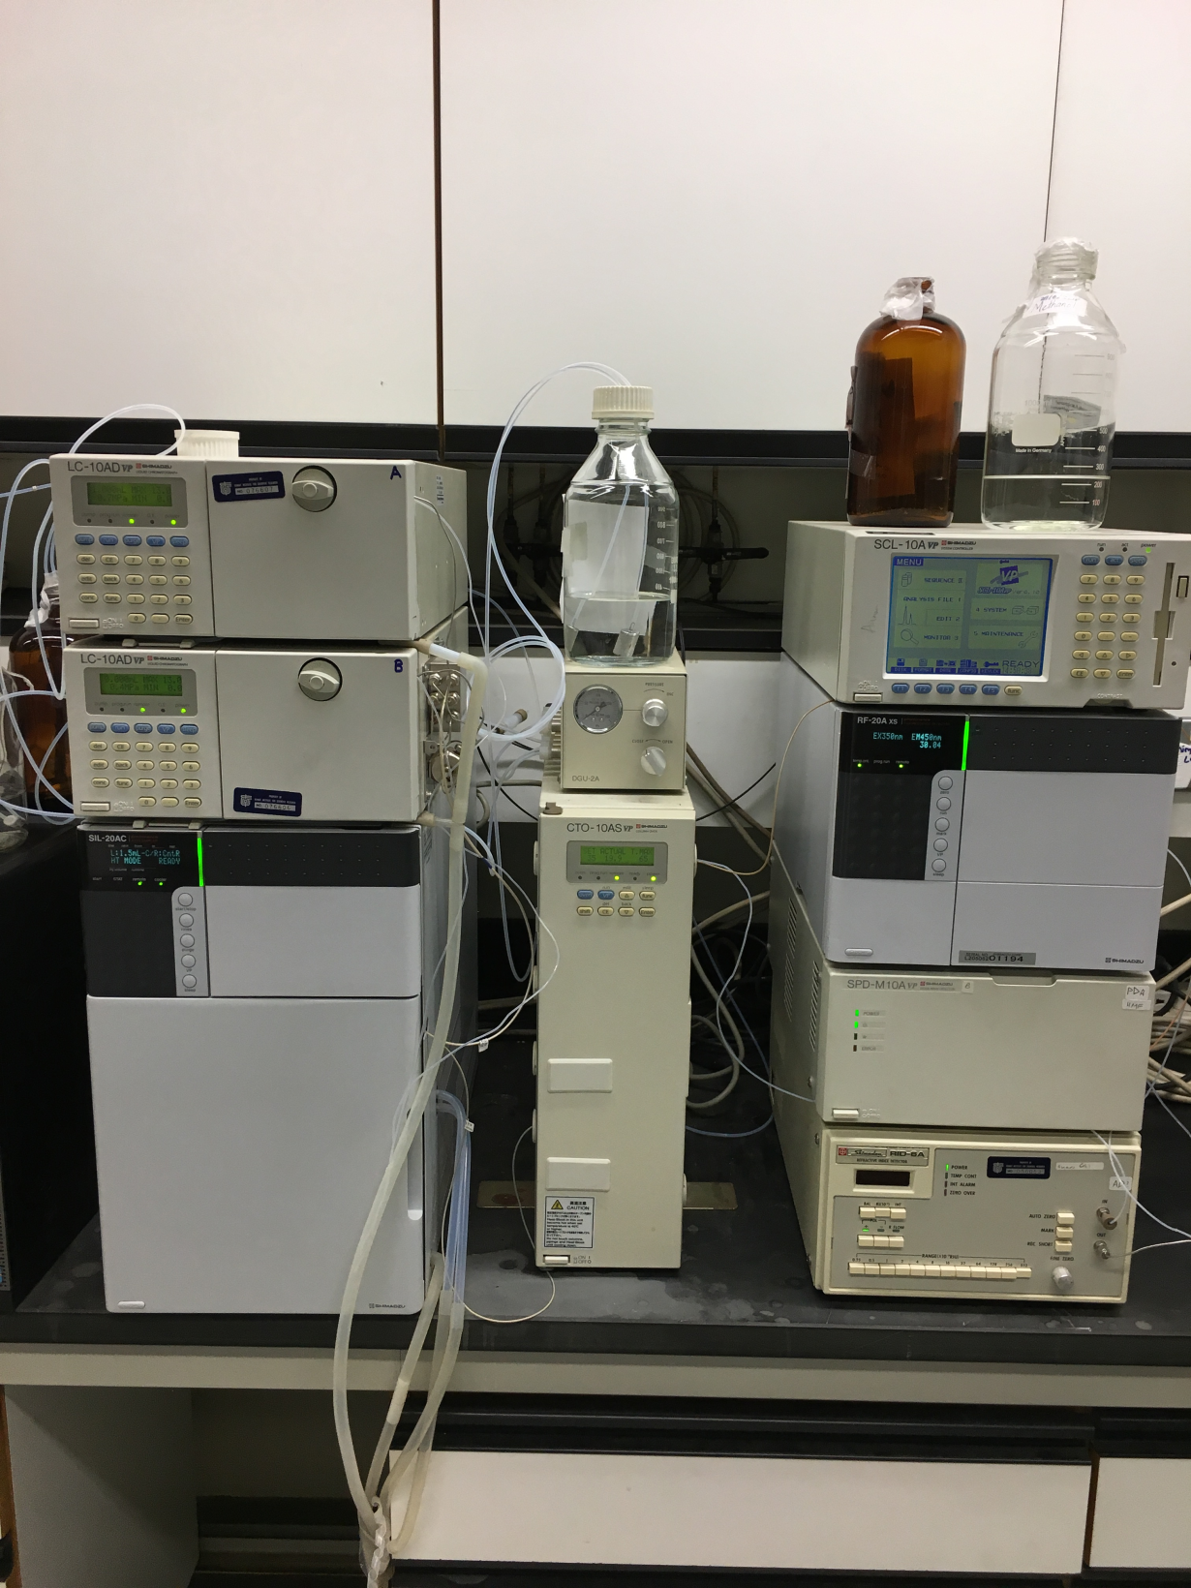
HPLC
Shimadzu, Japan

Slide 76
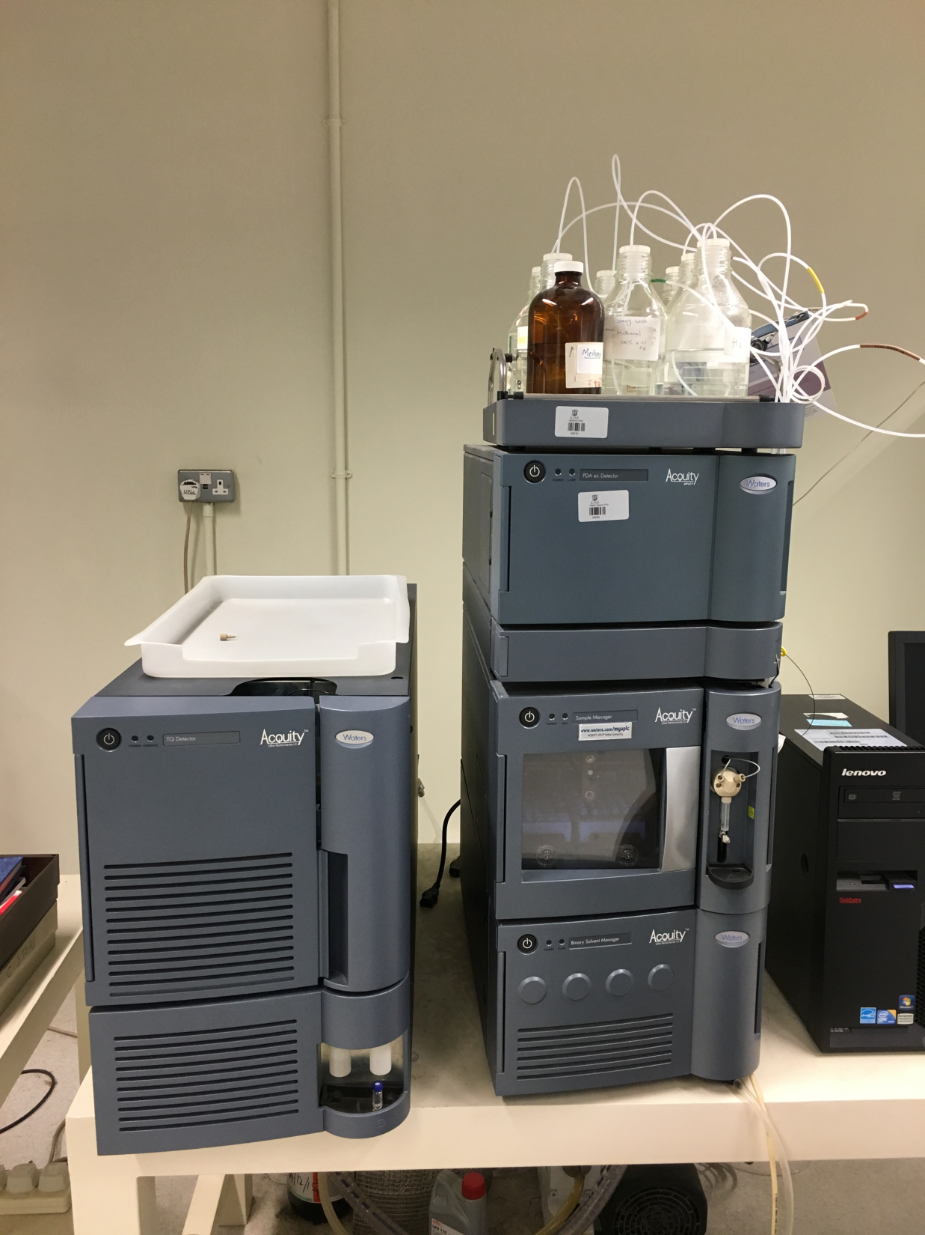
LC-MS-MS
Waters, USA

Slide 77
Issues and challenges of a Halal laboratory
None of the standards specify test protocols required for Halal verification.
There are no endorsed or approved test methods or standards for critical tests.
Development of test methods equipment needed for critical or specialized tests are very expensive (GC-MS, LC-MS, PCR, FTIR, etc.).
The employment of a Muslim analyst or technical staff could be difficult.

Slide 78
Available developed Halal test methods are monopolized by some Halal R&D institutions like UPM of Malaysia, and available at high cost.

Slide 79
Requirements of GSO-GAC for Halal Laboratory
GAC
Halal Laboratory is a Halal Certifying Body that provide Halal services in a form of Halal analysis on food and non-food products.

Slide 80
To be accredited by GSO-GAC as a
Halal Certifying Body
then
One need to be accredited by fulfilling the requirements of GAC FAD-12 standard:
GAC FAD-12 standard: Halal Certification Bodies

Slide 81
Halal Certification Bodies are actually a product or a service certification bodies, and if they want to be accredited for GAC FAD-12 standard they must fulfill the requirements of the following three standards:
ISO/IEC 17065 requirements
Requirements for bodies certifying products, processes and services
GAC FAD-12
Halal Certification Bodies
GAC FAD 04
Product Certification Bodies

Slide 82
Supplementary accreditation requirements for GAC
Halal certification Bodies
FAD-12
Halal Certification Bodies
Scope of the standard FAD-12
General requirements
Structural requirements
Resources requirements
Minimum criteria for the competence of personnel & management of HCB (Halal services e.g. Halal laboratory)

Slide 83
Certification bodies whose systems do not follow this guidance in any respect will only be eligible for accreditation if they can demonstrate to GAC that their solutions meet the relevant clause of ISO/IEC 17065 in an equivalent way.
Accreditation results in Halal certification bodies being publicly identified as being competent to perform defined scopes of certification.
Accreditation offers ¹users of certification services, ²stakeholders and ³the community added assurance regarding the independence, impartiality and competence of the certification body.

Slide 84
Scope of the standard FAD-12
This Application document specifies the requirements that Halal certification bodies shall satisfy the requirements for the execution of Halal certification activities, such as certification of Halal product/service and/or processes for bodies providing these activities.
The material contained is mainly directed at certification of tangible Halal products. It can also be applied to certification of non-tangible Halal products (e.g. software, service) and to Halal process certification.
Unless otherwise noted, the word “product” is intended to include services and processes.

Slide 85
In establishing a Halal certification system the purpose is to demonstrate to the marketplace and/or regulators that a supplier can and does produce Halal products* in conformity with GCC requirements.
*or a service

Slide 86
General requirements
1. Legal and Islamic responsibility
2. Operations

Slide 87
1. Legal and Islamic responsibility
The halal certification body shall be with profound understanding of the proper supply of halal products/services to Muslims and shall take appropriate steps that ensure Islamic responsibilities are fulfilled in all the activities. The halal certification body shall have the responsibility for complying with all Islamic requirements.

Slide 88
2. Operations
The Halal certification body shall take all steps that are necessary to evaluate conformance with the relevant Halal product standards according to the requirements of specific Halal product certification system (e.g. for meat GSO-GAC 993).
The Halal certification body shall specify the relevant GCC standards or parts thereof and any other requirements such as sampling, testing and inspection requirements which form the basis for the applicable Halal certification system.

Slide 89
While conducting the halal certificate operations, the halal certification body shall ensure that the suitability and competence of body(ies) and person(s) carrying out testing, inspection, and halal certification fulfill the requirements, whichever applicable, stated in ISO/IEC 17025, ISO/IEC 17020, ISO/IEC 17021 and/or ISO/TS 22003.
ISO/IEC 17025
General requirements for the competence of testing and calibration laboratories

Slide 90
Structural requirements
1. Committee for safeguarding impartiality

Slide 91
1. Committee for safeguarding impartiality
The recognized Islamic authority of the country in which the halal certification body operates shall be represented in the committee for ensuring the impartiality.
It shall play an active role in reviewing in the light of Islamic principles the impartiality of the halal certification activities that are executed by the halal certification body and in deciding the rules, procedures and policies for halal certification from Islamic point of view.

Slide 92
The Islamic authority shall take due care of any concerns that arise due to discrepancies in Islamic knowledge, practices and understanding which are likely to compromise the impartiality.

Slide 93
Resources requirements
The Halal certification body shall ensure that all personnel involved in the audit¹ and certification² activities are Muslims who are technically competent and ethically committed to Islamic values.

Slide 94
Minimum criteria for the competence of personnel & management of HCB (Halal services e.g. Halal laboratory)
Training on Halal standard and related documents application
Training on quality management system
Training on product certification conformity¹ and safety management system².
The personnel of the Halal certification body can be ¹individual auditors who work for the halal certification body on a contract basis, or ²from other external sources.

Slide 95
The halal certification body shall maintain comprehensive records controlling the competence of all the staff it uses in particular areas, whether they are employees, employed on contract basis or provided by external bodies.

Slide 96
The Halal certification body shall require its personnel involved in the Halal certification to sign a contract or other documents in which they commit themselves to:
a) Comply with the rules defined by the Halal certification body, including those relating to confidentiality and independence from commercial and other interest(s).
b) Declare any previous and/or present association on their own part, or on the part of their employer, with a designer, producer or supplier of products to the Halal audit or certification of which they are to be assigned.

Slide 97
Work experience
The Halal certification body shall ensure that the technical auditor has a minimum of five (5) years of full-time work experience in the related industry¹, including at least two (2) years of work experience in quality assurance².
The technical auditor shall have at least two (2) years of work experience in product safety functions during production¹ or manufacturing², retailing³, inspection⁴ or enforcement⁵, or the equivalent.

Slide 98
Audit experience
The Halal certification body shall ensure that within the last three (3) years the technical auditor has performed at least twelve (12) certification audit days (like product/service) in at least four (4) organizations under the leadership of a qualified auditor.

Slide 99
Competencies
The competences of technical auditors shall be recorded [see Clause 7.4.5 c) of ISO 19011:2011] for each category and sector (see Annex A). The Halal certification body shall provide evidence of the successful evaluation.

Slide 100
Processes requirements
The Halal certification body shall precisely define the scope of certification in terms of Halal product/service categories (e.g. primary (raw material or intermediate product) production, food processing, packaging material production etc.), and sectors according to Annex A.
The Halal certification body shall not exclude part of the processes¹, sectors², products³ or services³ from the scope of certification when those processes, sectors, products or services influence the Halal requirements of the end products.

Slide 101
MANAGEMENT SYSTEM REQUIREMENTS FOR CERTIFICATION BODIES
All requirements given in ISO/IEC 17021:2011 shall apply.

Slide 102
Supplementary accreditation requirements for GAC
Product certification Bodies
BD-091007-10-03
FAD-4
Product Certification Bodies
(ISO/IEC 17065)

Slide 103
INTERNATIONAL STANDARD
ISO/IEC
17065
First edition
2012-09-15
Conformity assessment — Requirements for bodies certifying products, processes and services
Évaluation de la conformité — Exigences pour les organismes certifiant les produits, les procédés et les services
Reference number
ISO/IEC 17065:2012(E)
© ISO 2012

Slide 104
To be accredited by GSO-GAC as a
Halal Laboratory
then
One need in addition to be accredited fulfilling the requirements of GAC FAD-12 standard the Halal laboratory must also fulfill the requirements of ISO 17025:2005 standard:

Slide 105
INTERNATIONAL STANDARD
ISO/IEC
17025:2005
General requirements for the competence of testing and calibration laboratories

Slide 106
ISO/IEC 17025:2005 specifies the general requirements for the competence to carry out tests¹ and/or calibrations², including sampling³.
It covers testing and calibration performed using standard methods¹, non-standard methods², and laboratory-developed methods³.

Slide 107
It is applicable to all organizations performing tests¹ and/or calibrations².
These include, for example, first-, second- and third-party laboratories¹, and laboratories where testing and/or calibration forms part of inspection and product certification².

Slide 108
ISO/IEC 17025:2005 is applicable to all laboratories regardless of the number of personnel or the extent of the scope of testing and/or calibration activities.
When a laboratory does not undertake one or more of the activities covered by ISO/IEC 17025:2005, such as sampling¹ and the design/development² of new methods, the requirements of those clauses do not apply.

Slide 109
ISO/IEC 17025:2005 is for use by laboratories in developing their management system for quality¹, administrative² and technical operations³.
Laboratory customers¹, regulatory authorities² and accreditation bodies³ may also use it in confirming or recognizing the competence of laboratories.
ISO/IEC 17025:2005 is not intended to be used as the basis for certification of laboratories.
Look at slide # 65

Slide 110
The value of the Muslim government of having Halal analysis laboratories
The value of the Muslim government of having Halal analysis laboratories become so obvious when we have in mind the following challenges facing consumers globally:
Ingredients are becoming so complex to the extent that even manufacturers of finished food, pharmaceuticals, and cosmetics products do not know the origin of their raw materials.

Slide 111
Muslim countries markets being open to non-Muslim markets and this will put processed products manufactured by Muslim markets such as food, pharmaceuticals, and cosmetics under the risk of ingredients and processing techniques that doesn’t suits Muslim belief.

Slide 112
The fact that Muslim markets is becoming part of the international market will put locally processed products under the request of importers from Europe for example to accompany halal lab analysis certificates to satisfy their consumers.
Being part of GCC and with the Halal Standard being approved by GSO, this will put pressure on Kuwait authorities to fulfill the requirements of such standard (i.e. Haram free products).

Slide 113
Conclusions
Halal analysis is very difficult because of the wide use of hidden non-Halal by products (pork, non-Halal meat, insects, cow urine, ethyl alcohol) in food and non-food products.
Halal analysis can best be executed following approved Halal analysis protocols.
Adulteration and contamination by non-Halal components are major concern in food processing, cosmetics and pharmaceuticals.
Halal stake holders need to understand specific needs of Halal in products and services to meet requirements of Halal markets.
Many non-Halal ingredients can be replaced by alternative Halal ingredients that have been proven to be as good or even better.
Halal R & D is needed to fulfil the requirements of Halal laboratories.

Slide 114
Recommendations
Establishment of well Dedicated Halal and Quality Laboratories in a non-Muslim country.
Routine survey of products is an assurance for their Halalness.
Approve of Halal standard Test Protocols necessary for Halal verification.
Encourage innovation & commercialization of Halal Technologies.
Establishment of Halal Data Bank that can be use by every one.
Spread Halal Education among consumers in importing countries.
Encourage manufacturing and marketing of Halal Products.

Slide 115
Finally
The role of Halal and Quality laboratory is very clear
To extend strong technical support to Halal Certification Bodies thru issuance of certificate of approval.
No product can be certified to be truly Halal without the aid of Halal and Quality Testing laboratories.
Information dissemination نشر and implementation of product standards.
Technical training.

Slide 116
References: المصادر
Proceedings, 3rd IMT-GT (2009). International symposium on Halal science and management, UPM.
Halal food production (2004). Mian M. Riaz and Mohammad M. Chaudry, CRC Press.
Laboratory testing and Analysis for Halal (2010); IHI, D1AS 03.
Halal laboratory protocols & laboratory and laboratory testing (2008): Sandy E. Bucao, 1st National Halal convention.
The contribution of science and technology in determining the permissibility (Halalnes) of food products (2012); Nurrulhidaya A. Fedzlillah, Yakob B. CheMan, Mohammad Azizat Jumaludin, and Shuaimi Ab. Rahman in Revalation and Sciences, Vol., 02, No., 1

Slide 117
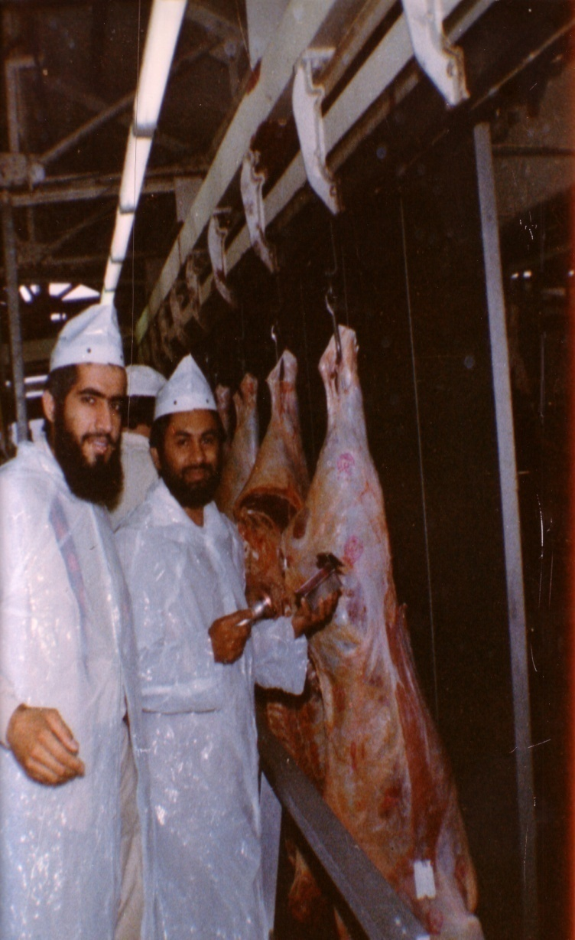
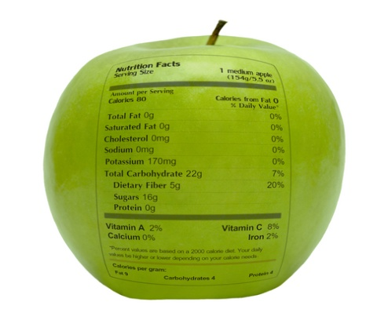
شكراً لاستماعكم
سبحنك اللهم وبحمدك أشهد أن لا إله إلا أنت، أستغفرك وأتوب إليك
د. هاني منصور المزيدي
مع الأخ أمجد محبوب في أستراليا سنة 1981
Dr. Hani Mansour Al-Mazeedi
With brother Amjad Mahboob in Australia in 1981

Slide 118
www.HalalEA.com
Trademarks, icons, images belong to their respective owners.
© Halal Sciences Academy Limited

